Slide 1

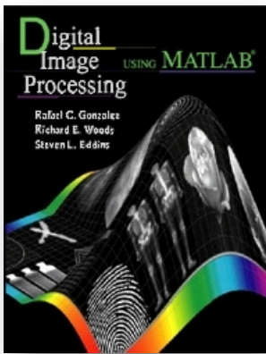
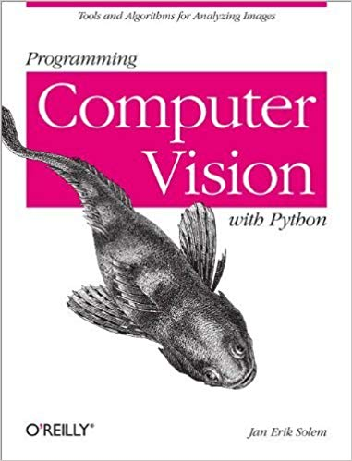
Fundamentals of Computer Vision
Last updated: 18-9-2024
[GR] Gonzalez, R. C., Woods, R.E. and Eddins, S.L., 2009. Digital Image Processing Using MATLAB, Fifth Impression. (Ch. 1)
[SR] Szeliski R., Computer Vision - Algorithms and Applications, Springer, 2011. (Ch. 2, 3)
[SJ] Solem, J. E., 2012. Programming Computer Vision with Python: Tools and algorithms for analyzing images. "O'Reilly Media, Inc.".
Dr. Zulfiqar Habib, Professor
http://vig.cuilahore.edu.pk
Notes:
Python: https://www.anaconda.com/

Slide 2
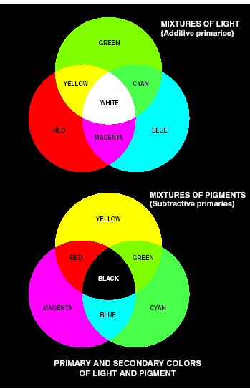
Color Spaces (Detail: Color Image Processing.pptx)
Primary Colors (RGB)
Red, Green, Blue
Secondary Colors (CMY)
Cyan (green + blue)
Magenta (red + blue)
Yellow (red + green)
An RGB to CMY conversion

Slide 3
Color Spaces
Hue: associated with the dominant wavelength in a mixture of light waves. It represents dominant color as perceived by an observer.
Saturation: refers to the relative purity or the amount of white light mixed with a hue.
Intensity (Value): associated with brightness
Hue, Saturation, and Intensity are making HSI or HSV color model
# Hue & saturation taken together are called chromaticity

Slide 4
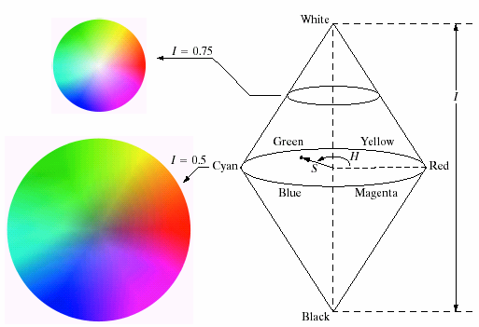
Color Spaces
Converting colors from RGB to HSI, RGB is normalized in [0,1]

Slide 5
Color Spaces
Converting colors from HSI to RGB, HSI is normalized in [0,1]
RG sector ( )
GB sector ( )
see book
BR sector ( )
see book

Slide 6
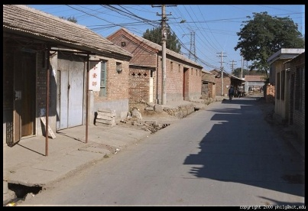
Analysis of Color Spaces RGB
Properties
Default color space and primary colors of light
Based on Cartesian coordinate system
It is an elementary & simplest representation based in terms of wavelengths of R, G & B in white light
Device-Independent
Applications
Used in various colored image processing applications including boundary extraction on color bases, segmentation and recognition of objects in color images
The hardware oriented models most commonly used RGB space
RGB is supported by various devices like Monitors, Cameras, etc.
R
G
B
Notes:
>> f=imread('building.jpg');
>> imshow(f)
>> fR = f(:, :, 1);
>> fG = f(:, :, 2);
>> fB = f(:, :, 3);
>> imshow(fR)
>> imshow(fG)
>> imshow(fB)
>> f1=cat(3, fR, fG, fB);
>> imshow(f1)

Slide 7
Analysis of Color Spaces RGB
Pros
More near to real colors
Simple and easy to implement
Matches nicely with the human visual system (eye), therefore strongly perceptive to R, G & B primaries.
Ideal for image color generation
R, G & B components with equal contributions produce a gray level shades
If components are contributed with their maximum equal strengths then white color is produced (Black if no contribution)
Cons
Not intuitive to human perception
High correlation between the channels
Mixing of chrominance and luminance data
Not perceptually uniform; small changes in RGB values may not correspond to visible changes
Notes:
Perceptually uniform means that a change of the same amount in a color value should produce a change of about the same visual importance, i.e., could be correlated with the visual appearance of colors (http://en.wikipedia.org/wiki/Lab_color_space)

Slide 8
Analysis of Color Spaces CMY
Properties
Secondary colors of light derived from RGB by subtracting one primary component
Applications
Used in most of devices that deposit colors on paper, such as printers, copiers, require CMY data.
Pros
The maximum equal contribution of all components of CMY produces black color
Cons
Not suitable for describing colors in terms that are practical for human interpretation

Slide 9
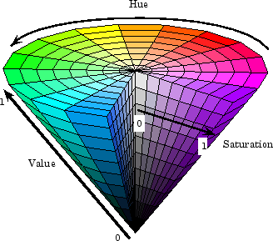
Analysis of Color Spaces HSV
Properties
Represented by almost cylindrical coordinates
Device-Dependent
Applications
Used in various Computer Graphics applications
Also used in image processing applications such as Image enhancement by manipulating
only its intensity channel
Medical image segmentation
using HSI model
H
S
V
Notes:
>> fHSV = rgb2hsv(f);
>> imshow(fHSV)
>> fH = fHSV(:,:,1); fS = fHSV(:,:,2); fV = fHSV(:,:,3);
>> imshow(fH)
>> imshow(fS)
>> imshow(fV)

Slide 10
Analysis of Color Spaces HSV
Pros
It is more near to how a human perceive any color. HSI model is natural and intuitive to humans
As intensity channel alone can be handled separately so brightness can be controlled by just dealing with this channel alone without affecting chromaticity information
Useful if we are dealing with a color separation/segmentation task in which we need to separate all different variations of one particular color
Cons
There is a difficulty in interpreting Hue component because:
there is discontinuity in the HSI model where θ = 0 & 360 meet and
Hue is undefined for a saturation of 0 (i.e. for white, Black and pure grays)
It is not perceptually uniform

Slide 11
Analysis of Color Spaces YCbCr
Properties
Y is the luma component
Cb & Cr are the blue & red
differences chroma components
Device-Dependent
Applications
Video encoding (used in TV broadcasting, DVD, etc.)
Image compression and transmission
Skin detection in face recognition systems
Y
Cb
Cr
Notes:
http://en.wikipedia.org/wiki/YCbCr
YCBCR = rgb2ycbcr(f);
>> Y=YCBCR(:,:,1);
>> Cb=YCBCR(:,:,2);
>> Cr=YCBCR(:,:,3);
>> imshow(Y)
>> imshow(Cb)
>> imshow(Cr)

Slide 12
Analysis of Color Spaces YCbCr
Pros
Useful if we need to change Brightness/Contrast component of a color image without altering the color component of that image
Better suited for compression algorithms as the human eye is more sensitive to luminance than chrominance
Cons
Lossy transformations from RGB can introduce artifacts
Not useful for all image processing tasks like edge detection or segmentation

Slide 13
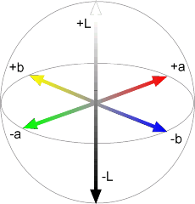
Analysis of Color Spaces L*a*b or CIELAB
Properties
Consists of L (lightness), a (green to red), and b (blue to yellow) channels
Device-Independent
Applications
Used in creative art, advertising, graphic art, digitized or animated paintings etc.
Applied to image coding for printing
Color calibration
Medical imaging especially dentistry
Segmentation of natural scenes
L
a
b
Notes:
CIE in CIELAB stands for the International Commission on Illumination (in French, Commission Internationale de l'Éclairage), which is an international authority responsible for standardizing lighting, color spaces, and other related areas.
http://en.wikipedia.org/wiki/Lab_color_space
>> C = makecform('srgb2lab');
>> LAB = applycform(f, C);
>> L = LAB(:,:,1);
>> A = LAB(:,:,2);
>> B = LAB(:,:,3);
>> imshow(L)
>> imshow(A)
>> imshow(B)

Slide 14
Analysis of Color Spaces L*a*b
Pros
Perceptually uniform; good for color comparison and recognition tasks.
L* values relates linearly to human perception of brightness.
It is useful in imaging systems where exact perceptual reproduction of color image across the entire system is of primary concern
It is useful if we need to change Brightness/Contrast component of a color image without altering the color component of that image
Cons
Complex transformation from RGB
Disadvantage in real time processing where computational resources are important

Slide 15
Analysis of Color Spaces Grayscale
Properties:
Removes color information, leaving only intensity (brightness)
Each pixel is a shade of gray ranging from black to white
Applications:
Edge detection, texture analysis, and other tasks where color is not needed
Simplifies tasks like image segmentation, feature extraction, and object detection
Pros:
Reduces computational complexity by working with a single channel
Easier to analyze certain visual features (edges, shapes, textures)
Cons:
Loses all color information, making it unsuitable for tasks that require color analysis
Can reduce accuracy for tasks that rely on color cues

Slide 16
Exercise
[SR, Ex. 2.8] Skin Color Detection: Test your program on your own picture and then on some others as well.
Hint: May use the combination of HSV and YCbCr color spaces
Relevant Readings:
http://www.hamradio.si/~s51kq/V-CIV.HTM
http://research.ijais.org/volume2/number2/ijais12-450264.pdf
Readers can search more…
Notes:
SkinColorDetection.m

Slide 17
Digital Image Processing (Detail: Image Enhancement-Spatial Domain.pptx)
Intensity Transformation
Histogram Processing
Spatial Filtering

Slide 18
Intensity Transformation
g(x, y) = T[f(x, y)] => s = T(r)
Image Negative
Power-Law
Logarithmic
Contrast Stretching

Slide 19
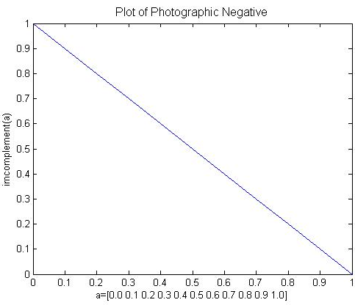
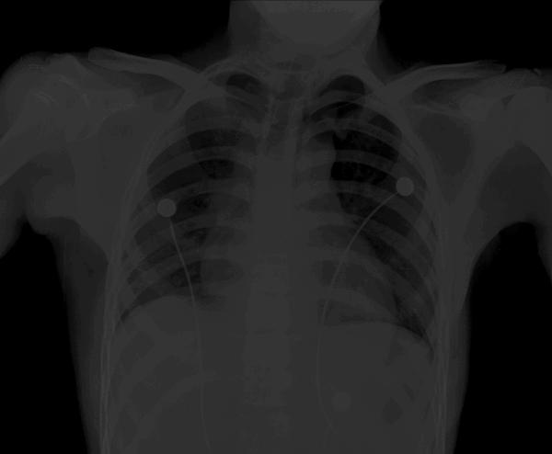
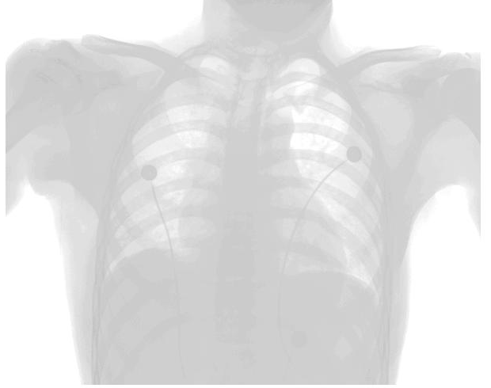
Intensity Transformation Image Negative
Image negative inverts the intensity of pixels. Here L = 2.
s = (L – 1) – r, where r ∈ [0, L-1].
>> f = imread('xray.tif');
>> g = imcomplement(f);
>> imshow(f), figure, imshow(g)

Slide 20
Intensity Transformation Power-Law (Gamma)
Useful for brightening the darkest regions (0 < γ < 1) or darkening the brightest regions in an image (γ > 1).
Here L = 2, s = r^{γ}
R = [10 100 200; 100 0 0; 10 18 100]
R = 10 100 200
100 0 0
10 18 100
R1=mat2gray(R) % range must be from 0 to 1
R1 = 0.0500 0.5000 1.0000
0.5000 0 0
0.0500 0.0900 0.5000
fGamaB = R1.^0.5
fGamaB = 0.2236 0.7071 1.0000
0.7071 0 0
0.2236 0.3000 0.7071
fGamaD = R1.^2
fGamaD = 0.0025 0.2500 1.0000
0.2500 0 0
0.0025 0.0081 0.2500

Slide 21
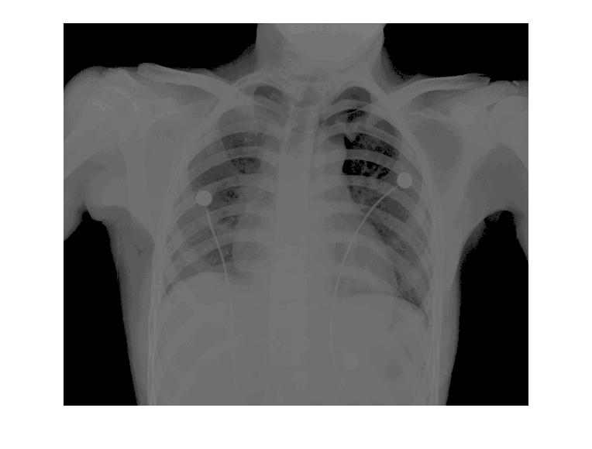
Intensity Transformation Power-Law (Gamma)
Syntax:
g = imadjust(f, [low_in high_in], [low_out high_out], gamma);
>> f = imread('xray.tif');
>> g = imadjust(f, [ ], [ ], 0.5);
>> imshow(f), figure, imshow(g)

Slide 22
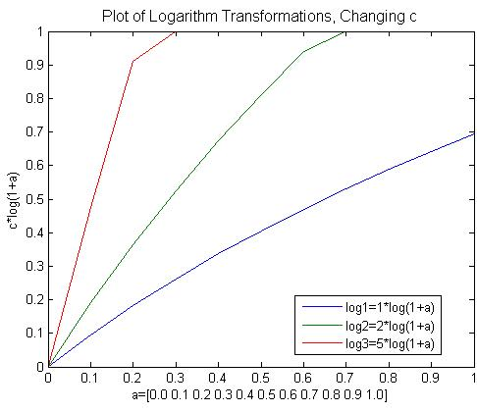
Intensity Transformation Logarithmic
Used to compress the dynamic range of values within an image.
s = c log(1 + double(r)), where c is constant
>> f = imread('spectrum.tif');
% here c = 1
>> g = im2uint8(mat2gray(log(1+double(f))));
>> imshow(f), figure, imshow(g)

Slide 23
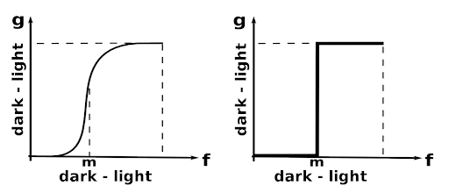
Intensity Transformation Contrast-Stretching
Used to compress the dynamic range of values within an image.
s = T(r) = 1 / (1 + (m/r)^{E}), where 0 < m < r
Output values are scaled to the range [0, 1]
g = 1./(1 + (m./(double(f) + eps)).^E)
>> f = imread('pollen.tif');
>> fd = im2double(f);
>> m = mean2(fd)
>> g = 1./(1+(m./(fd+eps)).^4);
>> imshow(f), figure, imshow(g)

Slide 24
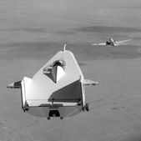
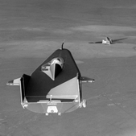
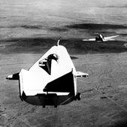
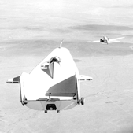
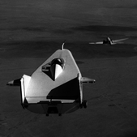
Intensity Transformation Exercise
Identify which intensity transformation was used on liftingbody.png to create each of the four results below. Write a script to reproduce the results using the intensity transformation functions.
Original
Result 1 Result 2 Result 3 Result 4

Slide 25
Histogram Processing
Generating & Plotting Image Histograms:
h(r_{k}) = n_{k}
where r_{k} is the k^{th} intensity value,
n_{k} is the number of pixels in the image with
intensity r_{k}.
Normalized Histogram:
p(r_{k}) = h(r_{k})/n
= n_{k}/n, (Relative frequency)
where n = MxN, the size of image
>> imhist(f);

Slide 26
Histogram Processing
Histogram Equalization
>> f = imread('pollen.tif');
>> h = histeq(f);
>> subplot(2,2,1), imshow(f), subplot(2,2,2), histogram(f), subplot(2,2,3), imshow(h), subplot(2,2,4), histogram(h)

Slide 27

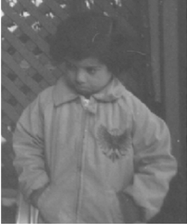


Exercise
Write a program which can read an image as an input and do the following automatically. Show the results of all steps.
Find the type of image: binary, gray or RGB.
Find the issue in image, over dark, over bright, low contrast, or normal. (Hint: can use histogram).
Resolve the issue if any and show the final image after enhancement.
Test your program on following images:

Slide 28
Neighborhood Processing

Slide 29
Spatial Filtering
w₁ w₂ w₃
w₄ w₅ w₆
w₇ w₈ w₉
f₁ f₂ f₃
f₄ f₅ f₆
f₇ f₈ f₉
g₁ g₂ g₃
g₄ g₅ g₆
g₇ g₈ g₉
g₅ = f₁*w₁+ f₂*w₂+ f₃*w₃+ f₄*w₄+ f₅*w₅+ f₆*w₆+ f₇*w₇+ f₈*w₈+ f₉*w₉

Slide 30
Spatial Filtering - Without Padding
Mask (Filter) Given Image Filtered Image
0 -1 0
-1 4 -1
0 -1 0
2 3 5 7 2
3 4 7 5 2
5 6 5 3 1
2 6 2 2 1
7 3 3 2 0
-3 ? ?
? ? ?
? ? ?
2*0 + 3*(-1) + 5*0 + 3*(-1) + 4*4 + 7*(-1) + 5*0 + 6*(-1) + 5*0 = -3

Slide 31
Spatial Filtering - With Zero Padding
0 -1 0
-1 4 -1
0 -1 0
2 3 5 7 2
3 4 7 5 2
5 6 5 3 1
2 6 2 2 1
7 3 3 2 0
2

Slide 32
Spatial Filtering - With Zero Padding
0 -1 0
-1 4 -1
0 -1 0
2 3 5 7 2
3 4 7 5 2
5 6 5 3 1
2 6 2 2 1
7 3 3 2 0
2
1

Slide 33
Spatial Filtering - With Zero Padding
0 -1 0
-1 4 -1
0 -1 0
2 3 5 7 2
3 4 7 5 2
5 6 5 3 1
2 6 2 2 1
7 3 3 2 0
2 1
3

Slide 34
Spatial Filtering - With Zero Padding
0 -1 0
-1 4 -1
0 -1 0
2 3 5 7 2
3 4 7 5 2
5 6 5 3 1
2 6 2 2 1
7 3 3 2 0
2 1 3
16

Slide 35
Spatial Filtering - With Zero Padding
0 -1 0
-1 4 -1
0 -1 0
2 3 5 7 2
3 4 7 5 2
5 6 5 3 1
2 6 2 2 1
7 3 3 2 0
2 1 3 16
-1

Slide 36
Spatial Filtering - With Zero Padding
0 -1 0
-1 4 -1
0 -1 0
2 3 5 7 2
3 4 7 5 2
5 6 5 3 1
2 6 2 2 1
7 3 3 2 0
2 1 3 16 -1
1

Slide 37
Spatial Filtering - With Zero Padding
0 -1 0
-1 4 -1
0 -1 0
2 3 5 7 2
3 4 7 5 2
5 6 5 3 1
2 6 2 2 1
7 3 3 2 0
2 1 3 16 -1
1
-3

Slide 38
Spatial Filtering - Padding Options
>> f=[1 2; 3 4]
f =
1 2
3 4
>> fp=padarray(f, [2 2], 0)
fp =
0 0 0 0 0 0
0 0 0 0 0 0
0 0 1 2 0 0
0 0 3 4 0 0
0 0 0 0 0 0
0 0 0 0 0 0
>> fp=padarray(f, [2 2], 'symmetric')
fp =
4 3 3 4 4 3
2 1 1 2 2 1
2 1 1 2 2 1
4 3 3 4 4 3
4 3 3 4 4 3
2 1 1 2 2 1
>> fp=padarray(f, [2 2], 'replicate')
fp =
1 1 1 2 2 2
1 1 1 2 2 2
1 1 1 2 2 2
3 3 3 4 4 4
3 3 3 4 4 4
3 3 3 4 4 4
>> fp=padarray(f, [2 2], 'circular')
fp =
1 2 1 2 1 2
3 4 3 4 3 4
1 2 1 2 1 2
3 4 3 4 3 4
1 2 1 2 1 2
3 4 3 4 3 4

Slide 39
Basic Types of Spatial Filtering
In spatial filtering (vs. frequency domain filtering), the output image is computed directly by simple calculations on the pixels of the input image.
Spatial filtering can be either linear or non-linear.
For each output pixel, some neighborhood of input pixels is used in the computation.
In general, linear filtering of an image f of size MxN with a filter mask of size mxn is given by
where a = (m-1)/2 and b = (n-1)/2
This concept is called convolution. Filter masks are sometimes called convolution masks or convolution kernels.

Slide 40
Basic Types of Spatial Filtering
Nonlinear spatial filtering usually uses a neighborhood too, but some other mathematical operations are used. These can include conditional operations (if …, then …), statistical (sorting pixel values in the neighborhood, mean, median), etc.

Slide 41
Median Filtering - With Zero Padding
2 3 5 7 2
3 4 7 5 2
5 6 5 3 1
2 6 2 2 1
7 3 3 2 0
0

Slide 42
Median Filtering - With Zero Padding
2 3 5 7 2
3 4 7 5 2
5 6 5 3 1
2 6 2 2 1
7 3 3 2 0
0
3

Slide 43
Median Filtering - With Zero Padding
2 3 5 7 2
3 4 7 5 2
5 6 5 3 1
2 6 2 2 1
7 3 3 2 0
0 3
4

Slide 44
Nonlinear Spatial Filtering - Example
>> f = imread('cktboard.tif');
>> fn = imnoise(f, 'salt & pepper', 0.2);
>> gm = medfilt2(fn);
>> gms = medfilt2(fn, 'symmetric');
>> imshow(f), figure, imshow(fn), figure, imshow(gm), figure, imshow(gms)
(a)
(b)
(c)
(d)

Slide 45
Segmentation of Water in Bottles
b = imread('bottles.jpg');
bL = im2bw(b,0.2);
bH = im2bw(b,0.7);
L = (bL-bH);
L1 = medfilt2(L,[9 9],'symmetric');
subplot(2,3,1),imshow(b),title('Bottles'),
subplot(2,3,2), imshow(bL), title('Liquid White'),
subplot(2,3,3), imshow(bH), title('Liquid Black'),
subplot(2,3,4), imshow(L), title('Liquid with noise'),
subplot(2,3,5), imshow(L1), title('Pure Liquid')

Slide 46
Morphology (Detail: Morphological Image Processing.pptx)
Morphological image processing (or morphology) describes a range of image processing techniques that deal with the shape (or morphology) of features in an image
Morphological operations are typically applied to remove imperfections introduced during segmentation, boundary extraction, pruning, thinning, Skeletonization, etc.

Slide 47
Structuring Elements, Hits & Fits
B
Structuring Element
Fit: All on pixels in the structuring element cover on pixels in the image
Hit: Any on pixel in the structuring element covers an on pixel in the image
Miss: No on pixel in the structuring element covers an on pixel in the image
A
C
All morphological processing operations are based on these simple ideas

Slide 48
Fitting & Hitting
0 | 0 | 0 | 0 | 0 | 0 | 0 | 0 | 0 | 0 | 0 | 0
0 | 0 | 0 | 1 | 1 | 0 | 0 | 0 | 0 | 0 | 0 | 0
0 | 0 | 1 | 1 | 1 | 1 | 1 | 0 | 0 | 0 | 0 | 0
0 | 1 | 1 | 1 | 1 | 1 | 1 | 1 | 0 | 0 | 0 | 0
0 | 1 | 1 | 1 | 1 | 1 | 1 | 1 | 0 | 0 | 0 | 0
0 | 0 | 1 | 1 | 1 | 1 | 1 | 1 | 0 | 0 | 0 | 0
0 | 0 | 1 | 1 | 1 | 1 | 1 | 1 | 1 | 0 | 0 | 0
0 | 0 | 1 | 1 | 1 | 1 | 1 | 1 | 1 | 1 | 1 | 0
0 | 0 | 0 | 0 | 0 | 1 | 1 | 1 | 1 | 1 | 1 | 0
0 | 0 | 0 | 0 | 0 | 0 | 0 | 0 | 0 | 0 | 0 | 0
1 | 1 | 1
1 | 1 | 1
1 | 1 | 1
B
C
Structuring Element 1
0 | 1 | 0
1 | 1 | 1
0 | 1 | 0
A
Structuring Element 2

Slide 49
Structuring Elements
Structuring elements can be any size and make any shape
However, for simplicity we will use rectangular structuring elements with their origin at the middle pixel
0 | 0 | 1 | 0 | 0
0 | 1 | 1 | 1 | 0
1 | 1 | 1 | 1 | 1
0 | 1 | 1 | 1 | 0
0 | 0 | 1 | 0 | 0
1 | 1 | 1
1 | 1 | 1
1 | 1 | 1
0 | 1 | 0
1 | 1 | 1
0 | 1 | 0

Slide 50
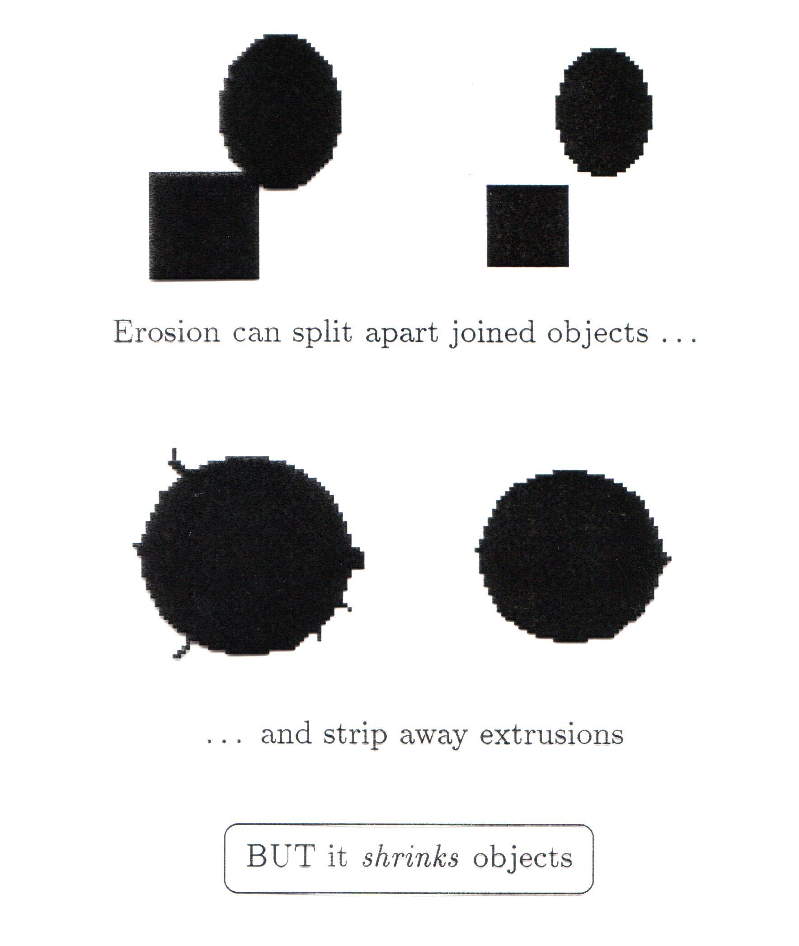
Erosion
Erosion of image f by structuring element s is given by f  s
The structuring element s is positioned with its origin at (x, y) and the new pixel value is determined using the rule:
Erosion shrinks objects

Slide 51
Erosion Example
Original Image
Processed Image With Eroded Pixels
Structuring Element

Slide 52
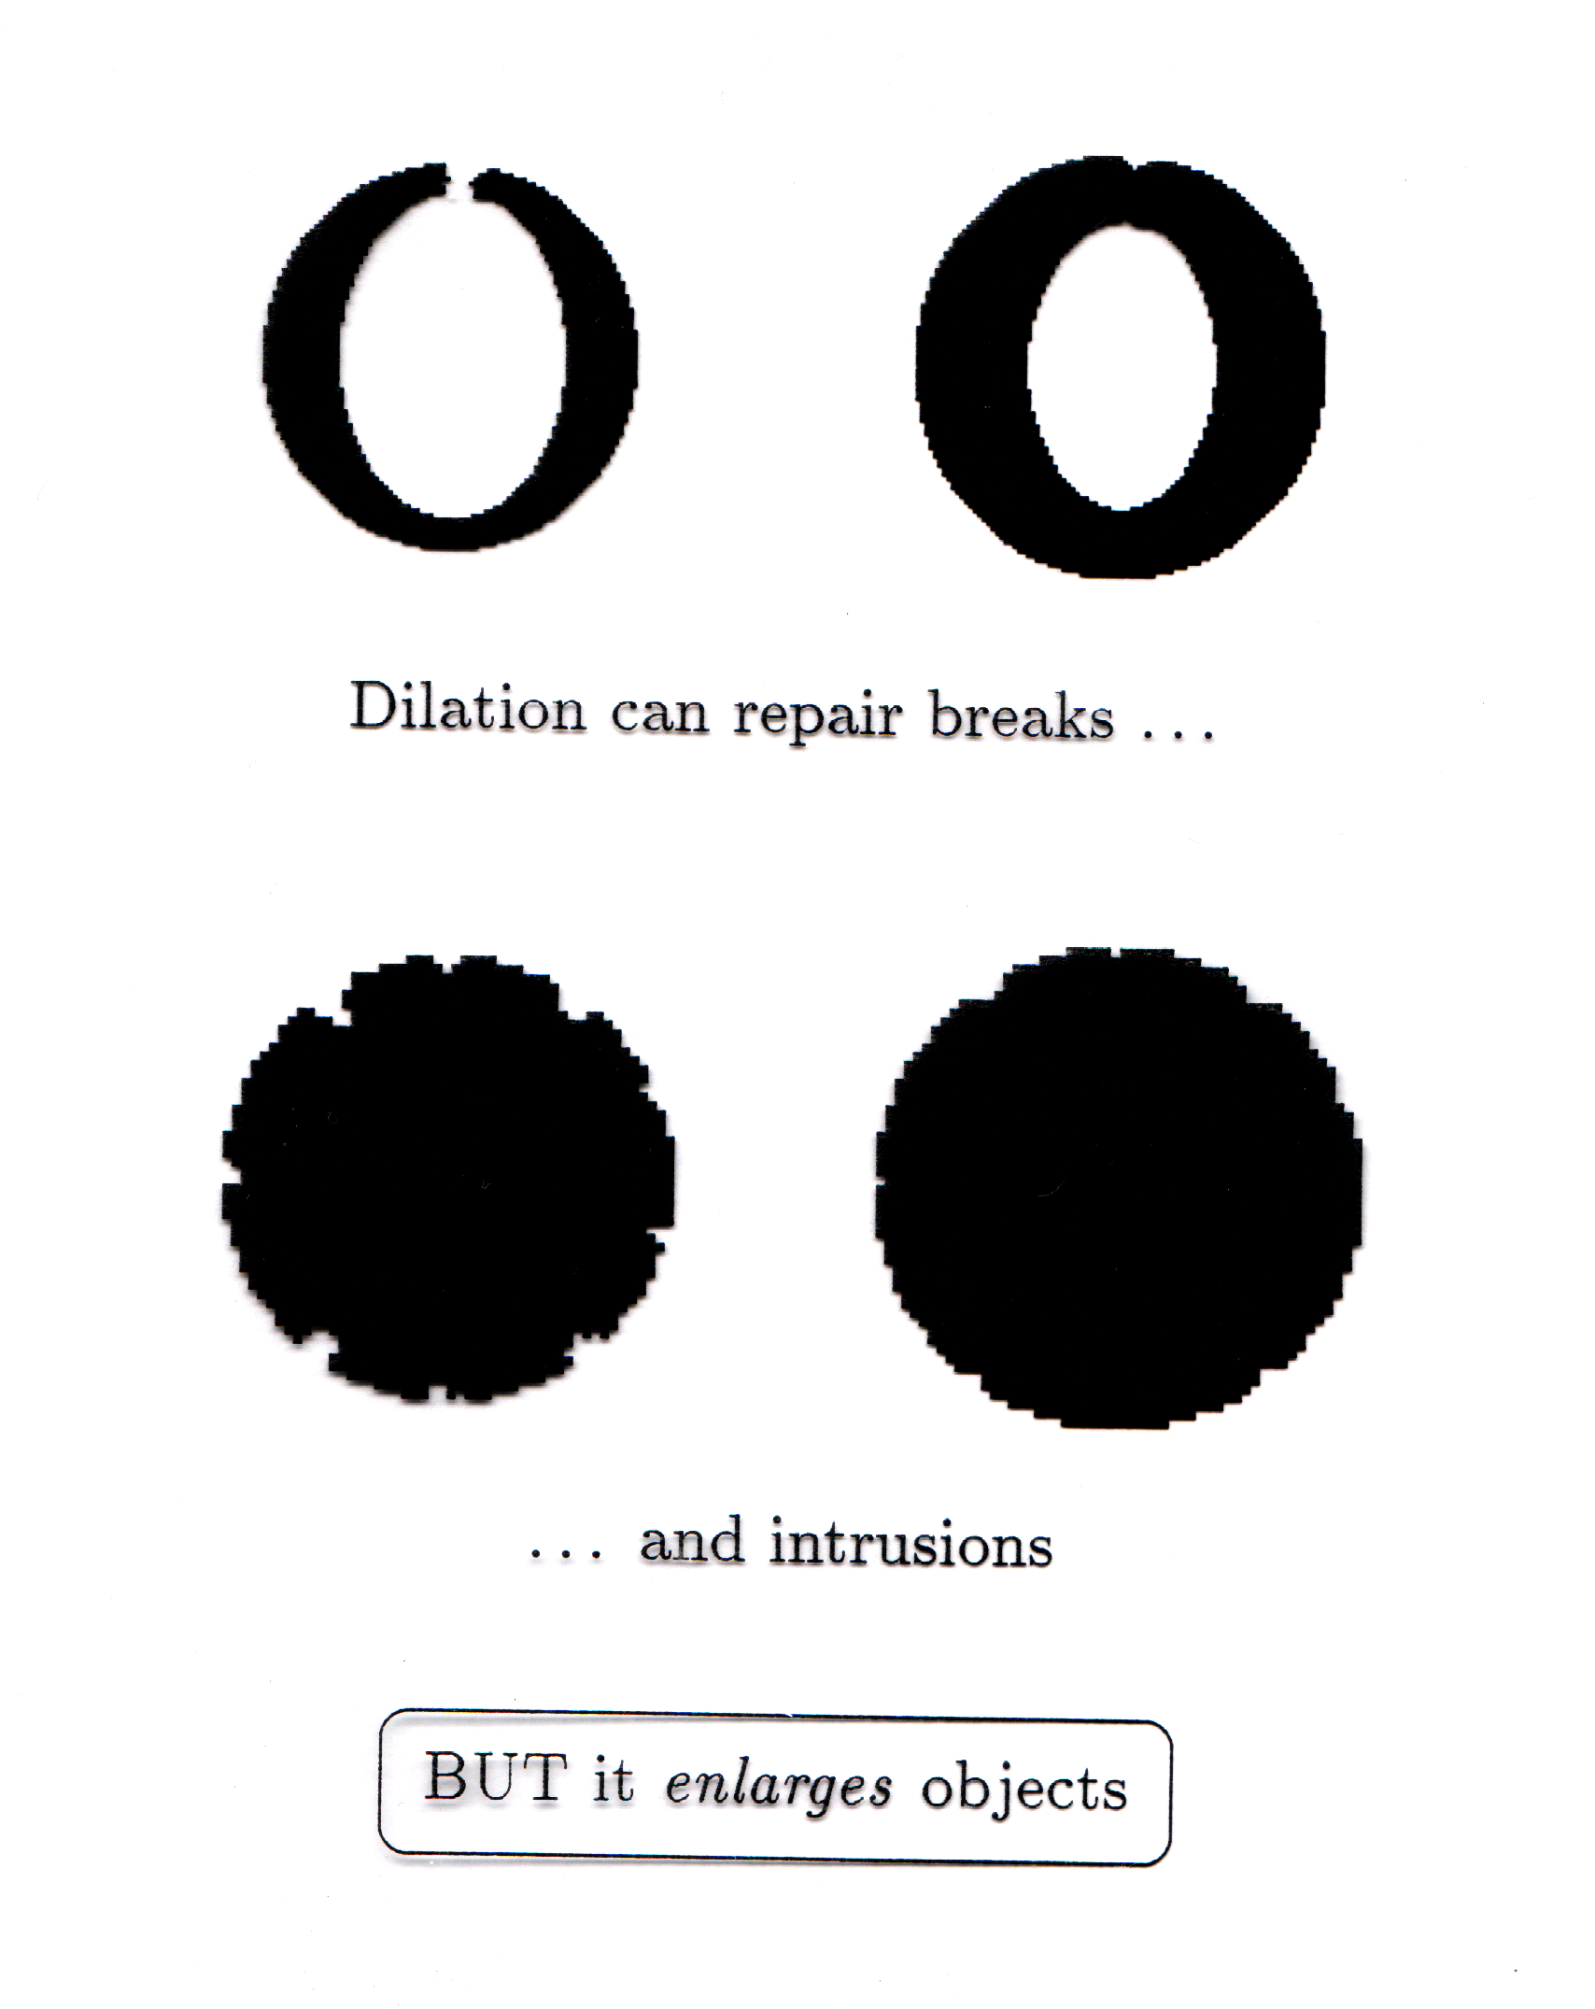
Dilation
Dilation of image f by structuring element s is given by f ⊕ s
The structuring element s is positioned with its origin at (x, y) and the new pixel value is determined using the rule:
Dilation enlarges objects

Slide 53
Dilation Example
Original Image
Processed Image
Structuring Element

Slide 54
Morphological Operations
More interesting morphological operations can be performed by performing combinations of erosions and dilations
The most widely used of these compound operations are:
Opening: f ○ s = (f  s) ⊕ s
Closing: f • s = (f ⊕ s)  s

Slide 55
Segmentation of Water in Bottles
b = imread('bottles.jpg');
t=double(multithresh(b,2))/256
bL = im2bw(b,t(1));
bH = im2bw(b,t(2));
L = bL - bH;
se5 = strel('disk',5);
se10 = strel('disk',10);
L1 = imopen(L,se5);
L2 = imclose(L1,se10);
subplot(2,3,1),imshow(b),title('Bottles'),
subplot(2,3,2), imshow(bL), title('Liquid White'),
subplot(2,3,3), imshow(bH), title('Liquid Black'),
subplot(2,3,4), imshow(L), title('Liquid with noise'),
subplot(2,3,5), imshow(L1), title('Liquid with less noise'),
subplot(2,3,6), imshow(L2), title('Pure Liquid');

Slide 56
Connected Components
The term connected component is defined in terms of a path, and the definition of a path in turn depends on adjacency.
To develop computer programs that locate & operate on objects, we need a set of definition for key terms.
N₄(p): the set of 4-neighbors of p
N₈(p): the set of 8-neighbors of p
p
p
Notes:
http://sites.google.com/site/ipum2009/chapter9-code

Slide 57
Connected Components
Two pixels p & q are said to be:
4-Adjacent if q∈N₄(p)
8-Adjacent if q∈N₈(p)
0 | 0 | 0 | 0 | 0
0 | 0 | 1 | 1 | 1
0 | 0 | 1 | 0 | 0
1 | 1 | 1 | 0 | 0
0 | 0 | 0 | 0 | 0
p
0 | 0 | 0 | 0 | 0
0 | 0 | 0 | 1 | 1
0 | 0 | 1 | 0 | 0
1 | 1 | 0 | 0 | 0
0 | 0 | 0 | 0 | 0
p

Slide 58
Connected Components
A path between pixels p₁ and p_{n} is a sequence of pixels p₁, p₂,…,p_{n-1}, p_{n} s.t., p_{k} is adjacent to p_{k+1}, for 1≤k<n. A path can be:
4-connected or 8-connected.
Two pixels p & q are said to be 4 (or 8-connectd) if there exist a 4 (or 8-connected) path between them, consisting entirely of foreground pixels.
0 | 0 | 0 | 0 | 0
0 | 0 | 1 | 1 | 1
0 | 0 | 1 | 0 | 0
1 | 1 | 1 | 0 | 0
0 | 0 | 0 | 0 | 0
p
0 | 0 | 0 | 0 | 0
0 | 0 | 1 | 1 | 1
0 | 0 | 1 | 0 | 0
1 | 1 | 0 | 0 | 0
0 | 0 | 0 | 0 | 0
p

Slide 59
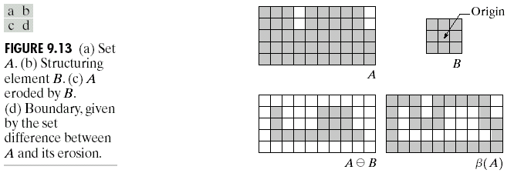
Boundary Extraction
Extracting the boundary (or outline) of an object is often extremely useful. The boundary can be given simply as
β(A) = A – (AB)
0 | 0 | 0 | 0 | 0
0 | 0 | 1 | 1 | 1
0 | 0 | 1 | 0 | 0
1 | 1 | 1 | 0 | 0
0 | 0 | 0 | 0 | 0
4-connected boundary
0 | 0 | 0 | 0 | 0
0 | 0 | 1 | 1 | 1
0 | 0 | 1 | 0 | 0
1 | 1 | 0 | 0 | 0
0 | 0 | 0 | 0 | 0
How to find 8-connected boundary?

Slide 60
Labeling Connected Components
1 | 1 | 1 | 0 | 0 | 0 | 0 | 0
1 | 1 | 1 | 0 | 1 | 1 | 0 | 0
1 | 1 | 1 | 0 | 1 | 1 | 0 | 0
1 | 1 | 1 | 0 | 0 | 0 | 1 | 0
1 | 1 | 1 | 0 | 0 | 0 | 1 | 0
1 | 1 | 1 | 0 | 0 | 0 | 1 | 0
1 | 1 | 1 | 0 | 0 | 1 | 0 | 0
1 | 1 | 1 | 0 | 0 | 0 | 0 | 0
1 | 1 | 1 | 0 | 0 | 0 | 0 | 0
1 | 1 | 1 | 0 | 2 | 2 | 0 | 0
1 | 1 | 1 | 0 | 2 | 2 | 0 | 0
1 | 1 | 1 | 0 | 0 | 0 | 4 | 0
1 | 1 | 1 | 0 | 0 | 0 | 4 | 0
1 | 1 | 1 | 0 | 0 | 0 | 4 | 0
1 | 1 | 1 | 0 | 0 | 3 | 0 | 0
1 | 1 | 1 | 0 | 0 | 0 | 0 | 0
p
Four 4-Connected Components Label Matrix
f = [1 1 1 0 0 0 0 0; 1 1 1 0 1 1 0 0; 1 1 1 0 1 1 0 0; 1 1 1 0 0 0 1 0; 1 1 1 0 0 0 1 0; 1 1 1 0 0 0 1 0; 1 1 1 0 0 1 0 0; 1 1 1 0 0 0 0 0];
[L, n]= bwlabel(f, 4) % L is exactly label matrix & n is number of labels

Slide 61
Labeling Connected Components
1 | 1 | 1 | 0 | 0 | 0 | 0 | 0
1 | 1 | 1 | 0 | 1 | 1 | 0 | 0
1 | 1 | 1 | 0 | 1 | 1 | 0 | 0
1 | 1 | 1 | 0 | 0 | 0 | 1 | 0
1 | 1 | 1 | 0 | 0 | 0 | 1 | 0
1 | 1 | 1 | 0 | 0 | 0 | 1 | 0
1 | 1 | 1 | 0 | 0 | 1 | 0 | 0
1 | 1 | 1 | 0 | 0 | 0 | 0 | 0
1 | 1 | 1 | 0 | 0 | 0 | 0 | 0
1 | 1 | 1 | 0 | 2 | 2 | 0 | 0
1 | 1 | 1 | 0 | 2 | 2 | 0 | 0
1 | 1 | 1 | 0 | 0 | 0 | 2 | 0
1 | 1 | 1 | 0 | 0 | 0 | 2 | 0
1 | 1 | 1 | 0 | 0 | 0 | 2 | 0
1 | 1 | 1 | 0 | 0 | 2 | 0 | 0
1 | 1 | 1 | 0 | 0 | 0 | 0 | 0
p
Four 8-Connected Components Label Matrix
f = [1 1 1 0 0 0 0 0; 1 1 1 0 1 1 0 0; 1 1 1 0 1 1 0 0; 1 1 1 0 0 0 1 0; 1 1 1 0 0 0 1 0; 1 1 1 0 0 0 1 0; 1 1 1 0 0 1 0 0; 1 1 1 0 0 0 0 0];
[L, n]= bwlabel(f, 8)

Slide 62
Labeling Connected Components
[r, c] = find(L==2)
r =
2
3
2
3
7
4
5
6
c =
5
5
6
6
6
7
7
7
1 | 1 | 1 | 0 | 0 | 0 | 0 | 0
1 | 1 | 1 | 0 | 2 | 2 | 0 | 0
1 | 1 | 1 | 0 | 2 | 2 | 0 | 0
1 | 1 | 1 | 0 | 0 | 0 | 2 | 0
1 | 1 | 1 | 0 | 0 | 0 | 2 | 0
1 | 1 | 1 | 0 | 0 | 0 | 2 | 0
1 | 1 | 1 | 0 | 0 | 2 | 0 | 0
1 | 1 | 1 | 0 | 0 | 0 | 0 | 0
Centroid = round([mean(r), mean(c)])
Centroid =
4 6

Slide 63
Labelling All Objects
f = imread('objects.tif');
[L, n]=bwlabel(f);
imshow(f)
hold on
for k =1:n
[r,c] =find(L==k);
rbar =mean(r);
cbar =mean(c);
plot(cbar, rbar, 'Marker', '*', 'MarkerEdgeColor', 'r');
end
objects.tif
Notes:
bwlabel(f) is 8-connected by defaults unless we write bwlabel(f, 4)

Slide 64
Labelling Incomplete Filled Bottles
b = imread('bottles.jpg');
t=double(multithresh(b,2))/256;
bL = im2bw(b,t(1));
bH = im2bw(b,t(2));
L = bL - bH;
se5 = strel('disk',5); se10 = strel('disk',10);
L1 = imopen(L,se5); L2 = imclose(L1,se10);
[bLabel, n] = bwlabel(L2);
imshow(b)
hold on
for k =1:n
[r,c] = find(bLabel==k);
rbar = mean(r);
cbar = mean(c);
if rbar > 280
plot(cbar, rbar, 'ro', 'LineWidth', 2);
end
end

Slide 65
Exercise
Collect some bottles at your home, partially and completely filled with some liquid. Take pictures of these bottles. Write a program which can label only incompletely filled bottles and test on these pictures.

Slide 66
Geometric Image Transformation (Detail: Geometric Transformation-2D.pptx)
Applications
Image Registration
Image Augmentation
Basic set of 2D geometric image transformations [SR, Fig. 3.45]

Slide 67
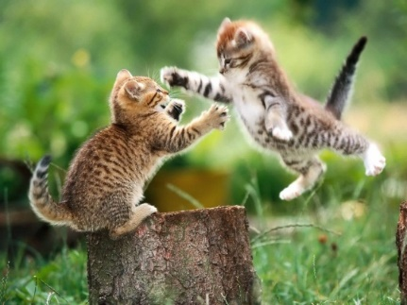



Geometric Image Transformation
Translation
Scaling
Rotation

Slide 68







Geometric Image Transformation
Aspect Ratio
Shearing
General Affine
Projective

Slide 69
Geometric Image Transformation
Euclidean (rigid) transform (3 DoF, Euclidean distances are preserved) = translation + rotation
Similarity transform (4 DoF, preserves angles between lines) = translation + scaling + rotation
Affine transform (6 DoF, Parallel lines remain parallel) = translation + rotation + scale + aspect ratio + shear
Projective transform (Homographies) (8 DoF, preserve straight lines)

Slide 70
Image Registration (Detail: Image Restoration.pptx)
Image registration is the process of aligning two or more images of the same scene.
Each input image is compared with a reference image—also known as base image.
A spatial transformation is applied to the input image in order to align it with the base image.
The key step in image registration is determining the parameters of the spatial transformation required to bring the images into alignment.

Slide 71
Image Registration - Applications
To align satellite images of the earth's surface.
To align images created by different medical diagnostic modalities (MRI and SPECT).
After registration, we can compare features in the images to see how a river has migrated, how an area is flooded, or to see if a tumor is visible in an MRI or SPECT image.

Slide 72
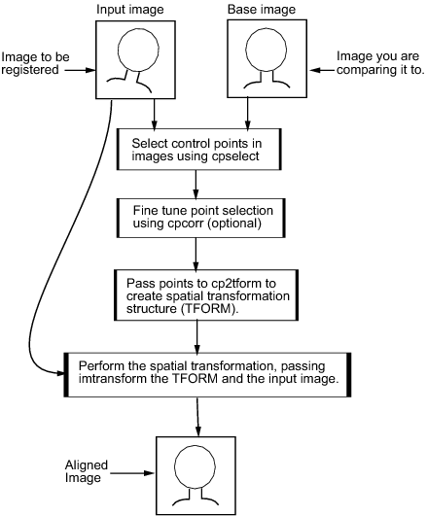
Image Registration
Point Mapping

Slide 73
Image Augmentation
is a technique used in computer vision and machine learning to artificially increase the size and diversity of a dataset. It involves applying various transformations to existing images to create new, but similar, images.
This helps to create a larger and more diverse dataset, which can improve the model’s learning ability to generalize and prevent overfitting.

Slide 74
Image Augmentation
Common image augmentation techniques include:
Flipping: Horizontally or vertically flipping the image.
Rotation: Rotating the image by a random angle.
Cropping: Randomly cropping a portion of the image.
Scaling: Changing the size of the image.
Translation: Shifting the image horizontally or vertically.
Color jittering: Randomly adjusting the brightness, contrast, saturation, and hue.
Noise addition: Adding random noise to the image.
Gaussian blur: Applying a Gaussian filter to blur the image.

Slide 75
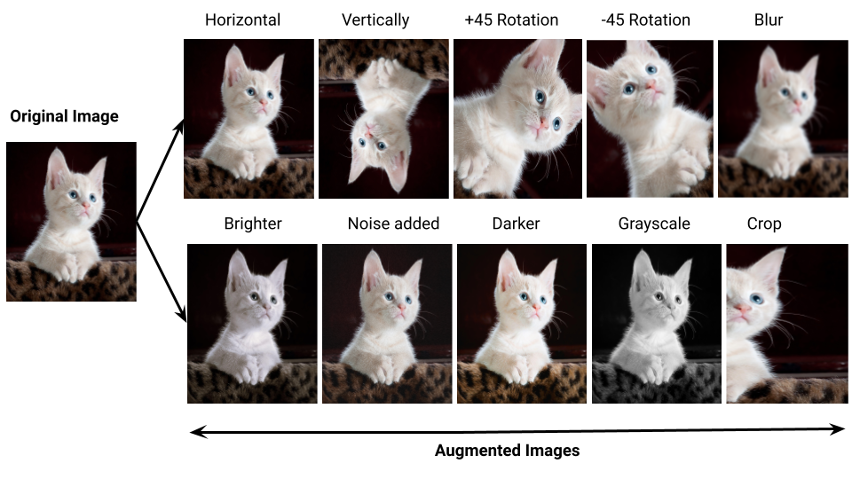
Image Augmentation

Slide 76
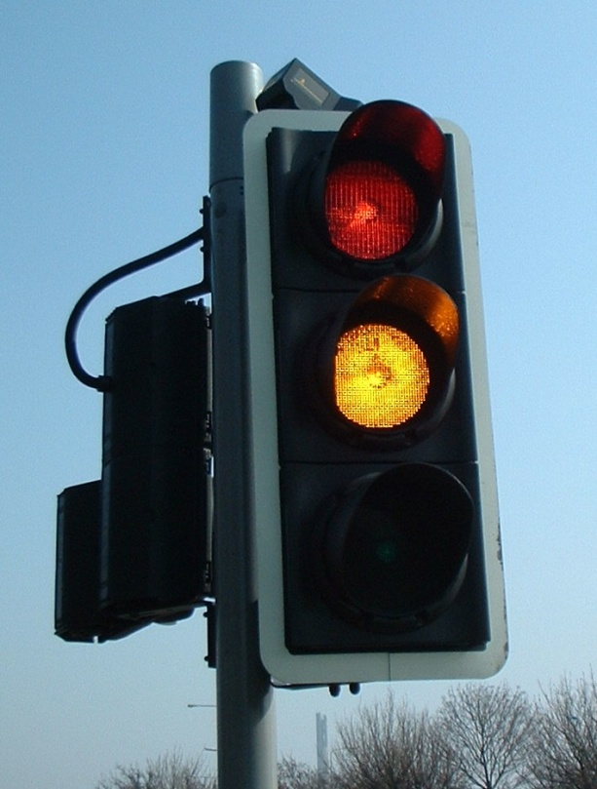
Exercise
Your company asks you to build a cheap traffic light monitoring system. You have a camera that observes a traffic light and should emit events when the light changes the color. How would you proceed?

